Slide 1
PICRUSt2, workflow and Analysis- DAWG Jan, 2020 Mara Cloutier
Available documents for DAWG members can be found here
https://github.com/picrust/picrust2
https://www.biorxiv.org/content/10.1101/672295v1

Slide 2
Inputs to run Picrust2 and Outputs
.biom/txt file
Seqs.fna file
Final output = tables of read depth/ASV * predicted function abundances/ASV
Not in relative abundances
Abundances per sample are different because no rarefying
Data needs to be transformed before running statistical tests either by taking relative abundance, centered-log ratio, z-scores, etc.

Slide 3
Getting .biom file
In R, you would do the following:
library(biomformat);packageVersion("biomformat")
otu<-t(as(otu_table(ps.full),"matrix")) # 't' to transform if taxa_are_rows=FALSE
otu_biom<-make_biom(data=otu)
write_biom(otu_biom,"otu.biom")

Slide 4
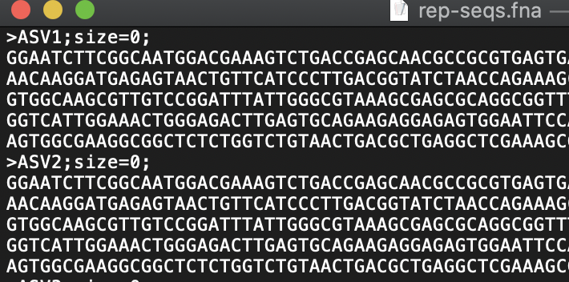
Exporting an .Fna file from R
uniquesToFasta(seqtab, fout='rep-seqs.fna', ids=colnames(seqtab))
# seqtab is the sequence table generated through the dada2 pipeline
# there is one problem with the resulting output file…
We don’t want to keep the ;size=0; portion of the ASV name, it will cause a problem in the pipeline later
Copy/paste fasta into excel, remove ;size=***; then copy/paste back into .fna file

Slide 5


Installing picrust2

Slide 6
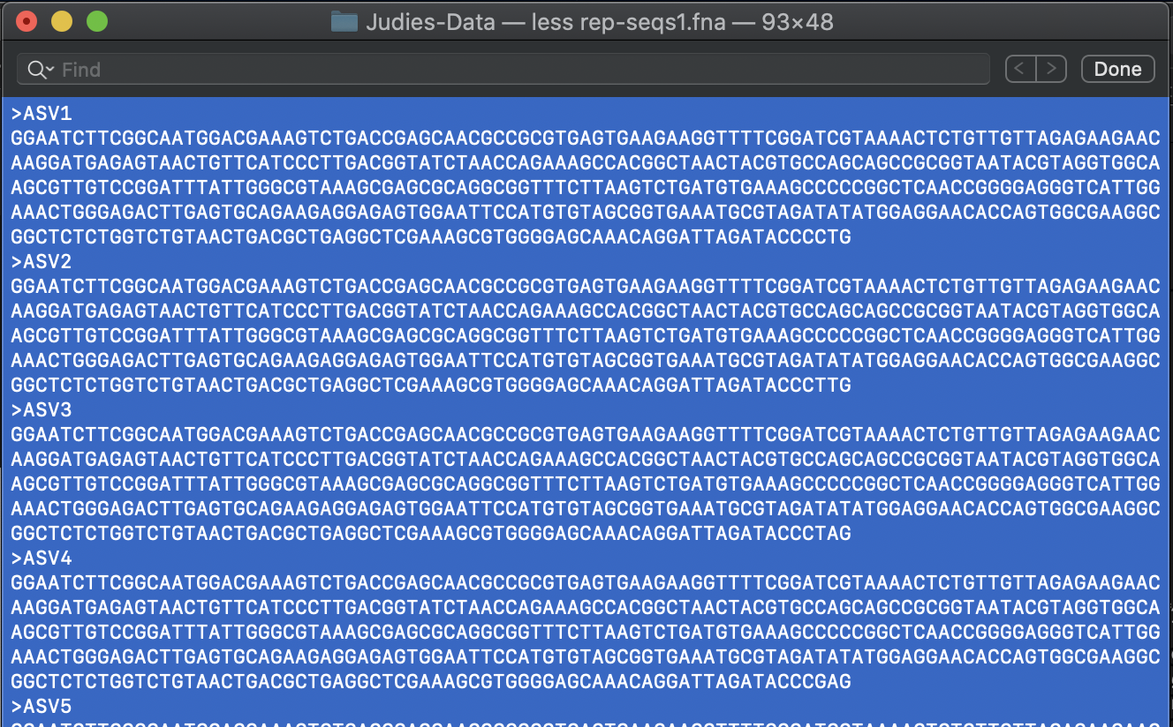
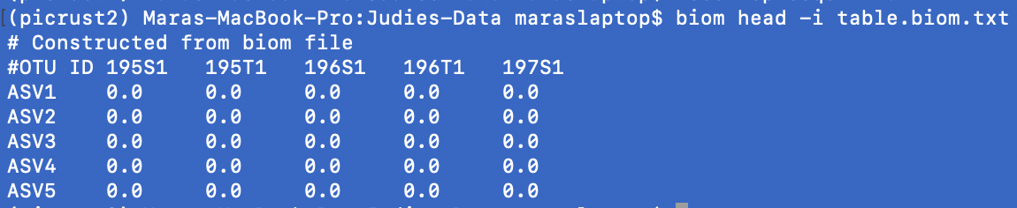
Starting picrust2 pipeline
Check out files by using:
less rep-seqs1.fna
Check out files by using:
biom head –i table.biom.txt

Slide 7
Making a reference tree
PICRUSt2 aligns ASV sequences with reference 16S sequences using HMMER
Once aligned, those sequences are placed into a reference phylogeny that is based on the reference 16S sequences (newick format tree)
Reference tree includes 20,000 16S sequences from IMG database
place_seqs.py -s rep-seqs1.fna -o out.tre -p 2 --intermediate intermediate/place_seqs

Slide 8
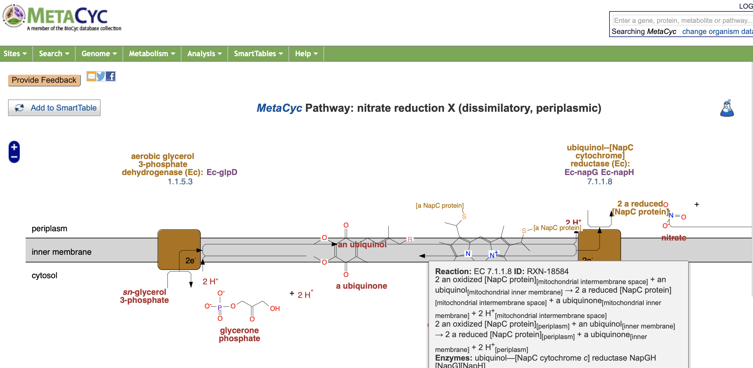
Inferring traits for unknown lineages
Predicts the genome for each ASV, can use EC (enzyme commission) or KEGG
EC numbers can be used in MetaCyc pathways
hsp.py –i EC –t out.tre –o EC-predicted.tsv.gz –p 1
This takes a little while…

Slide 9
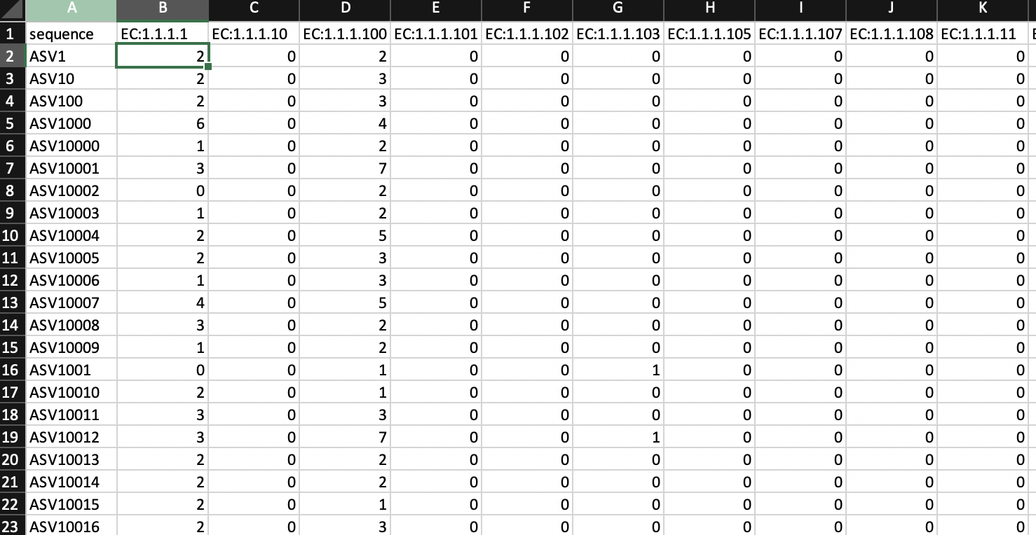
EC output file

Slide 10
Predicting # of 16S rRNA genes per ASV and nearest-sequenced taxon index values
Microbes have variable numbers of 16S rRNA gene copy numbers that are hypothesized to be relatively species/strain dependent
Escherichia coli has 7 copies, Bacillus subtilis has 23
Nearest-sequenced taxon index (NSTI) values represent how close the placed ASV is from the nearest reference 16S sequence – Closer distances = more accurate predictions, further distances = less accurate predictions
hsp.py -i 16S -t out.tre -o marker_predicted_and_nsti.tsv.gz -p 1 --calculate_NSTI

Slide 11
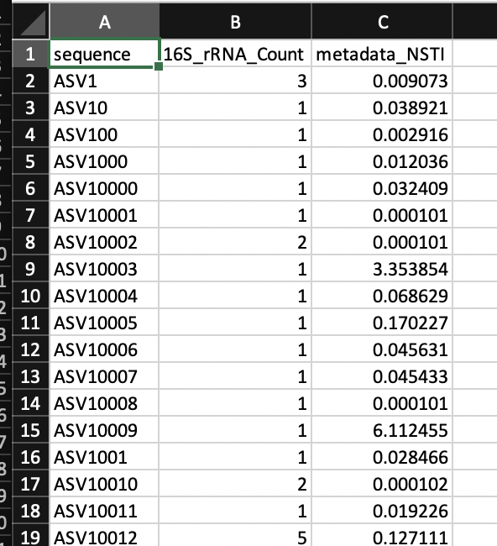
16S/NSTI tsv file

Slide 12
Hsp.py options
https://github.com/picrust/picrust2/blob/master/scripts/hsp.py
Can use it to predict number of 16S rRNA genes, COG, Enzyme classification (EC), KO (Kegg Orthology), PFAM, TIGRFAM, or PHENO

Slide 13
PREDICTED GENE FAMILIES WEIGHTED BY RELATIVE ABUNDANCE OF ASVS
“INFERRING METAGENOMES OF THE COMMUNITIES”
Takes biom file, which is the ASV table, divides the number of occurrences in the ASV table ~ the number of predicted 16S rRNA genes for that ASV
Multiplies resulting value by the predicted gene family copy numbers per ASV
metagenome_pipeline.py -i table.biom.txt -m marker_predicted_and_nsti.tsv.gz -f EC_predicted.tsv.gz -o EC_metagenome --strat_out

Slide 14

Calculation of Gene Family numbers
16S rRNA sequences from sequencing | Number of 16S rRNA genes per genome | Expected number of genomes | Number of EC:3.3.3.3 per genome | Number of functional genes in sample 1
100 | 7 | 14.3 | 2 | 28.6
500 | 23 | 21.7 | 1 | 21.7
40 | 12 | 3.3 | 5 | 16.67
Expected number of EC:3.3.3.3 genes in sample 1 is 67
Notes:
If Sample 1 has 100 sequences of ASV1, which is E. coli. & E. coli has 7 16S rRNA genes per copy, then there would be an estimated 100/7 = 14.3 E. coli genomes present in Sample 1
If there were an estimated 5 copies of the functional gene, EC:3.3.3.3 per E. coli genome, then Sample 1 would have approximately 71.5 EC:3.3.3.3 genes from E. coli
Now, E. coli is likely not the only bacteria that would have EC:3.3.3.3, therefore, the number of that functional gene is likely to be much higher depending on who is present/abundant

Slide 15
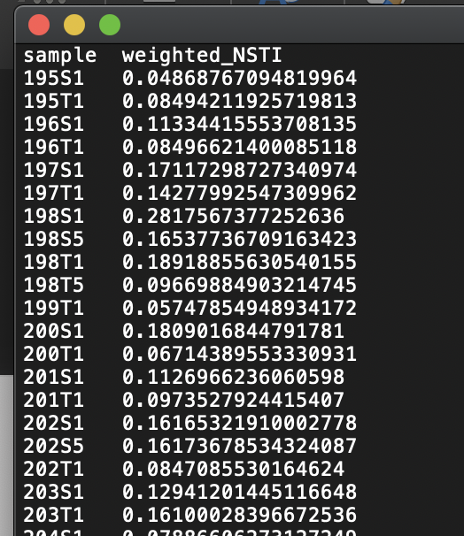
Metagenome_pipeline.py output files
Seqtab_norm.tsv.gz → ASV abundance table normalized by the predicted 16S gene copy number per ASV
Weighted_nsti.tsv.gz → mean NSTI value per sample – NSTI values between 0.06 – 0.15 are ideal

Slide 16
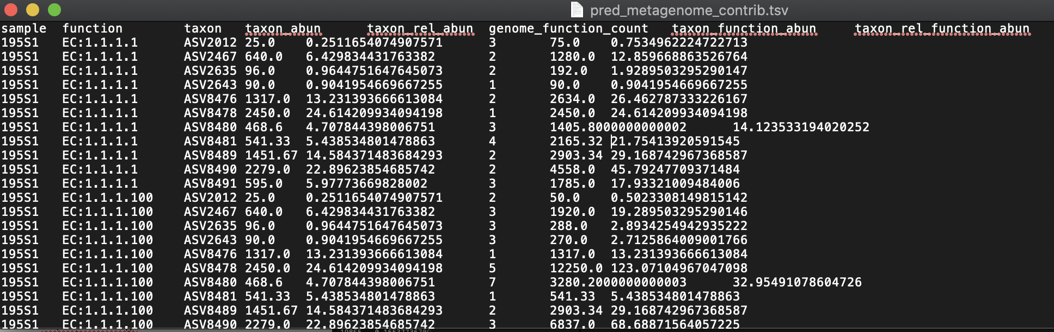
Metagenome_pipeline.py output files
Pred_metagenome_unstrat.tsv.gz → Overall EC abundances per sample
Pred_metagenome_contrib.tsv.gz →
Notes:
Taxon_abun = abundance of the ASV in the sample, which are normalized based on 16S gene copy numbers
Taxon_rel_abun = relative abundance, sample sum is 100
Genome_function_count = predicted copy number of the EC number per ASV
Taxon_function_abun = taxon_abun*genome_function_count
Taxon_rel_function_abun = taxon_rel_abun * genome_function_count
11 ASVs from the sample 195S1 have EC:1.1.1.1
EC:1.1.1.1 from ASV8490 has the highest relative abundance compared to the other EC:1.1.1.1

Slide 17
Metabolism Pathway inference
Groups EC numbers into MetaCyc reactions
Infers what pathways are present based on the reactions
Determines the abundances of pathways present

Slide 18
MEtaCyc pathway
pathway_pipeline.py -i EC_metagenome/pred_metagenome_contrib.tsv.gz -o MetaCyc-Pathways -p 1
Predicts ASV contributions to each pathway abundance for the entire community
Possible to predict pathway abundance per ASV but it is computationally intensive and not one of our goals for DAWG

Slide 19
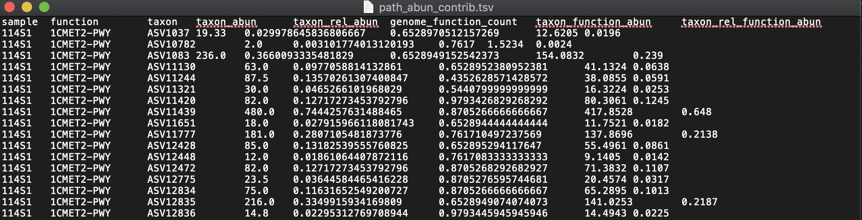
Predicted EC relative abundances
Predicted MetaCyc Pathway abundances

Slide 20
Add descriptions to the metagenome predictions
add_descriptions.py -i EC_metagenome/pred_metagenome_unstrat.tsv.gz -m EC -o EC_metagenome/pred_metagenome_unstrat_descrip.tsv.gz
add_descriptions.py -i pathways_out/path_abun_unstrat.tsv.gz -m METACYC -o pathways_out/path_abun_unstrat_descrip.tsv.gz

Slide 21
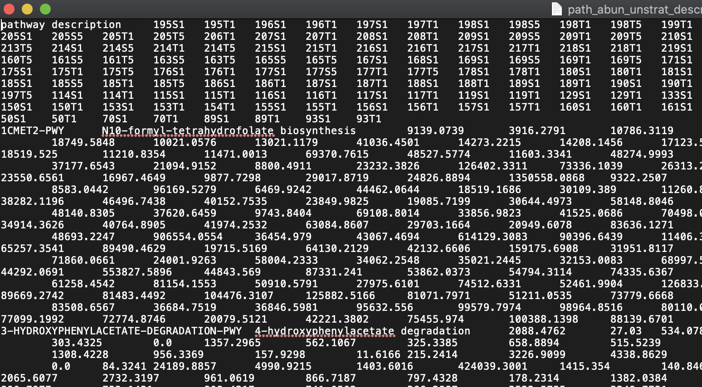
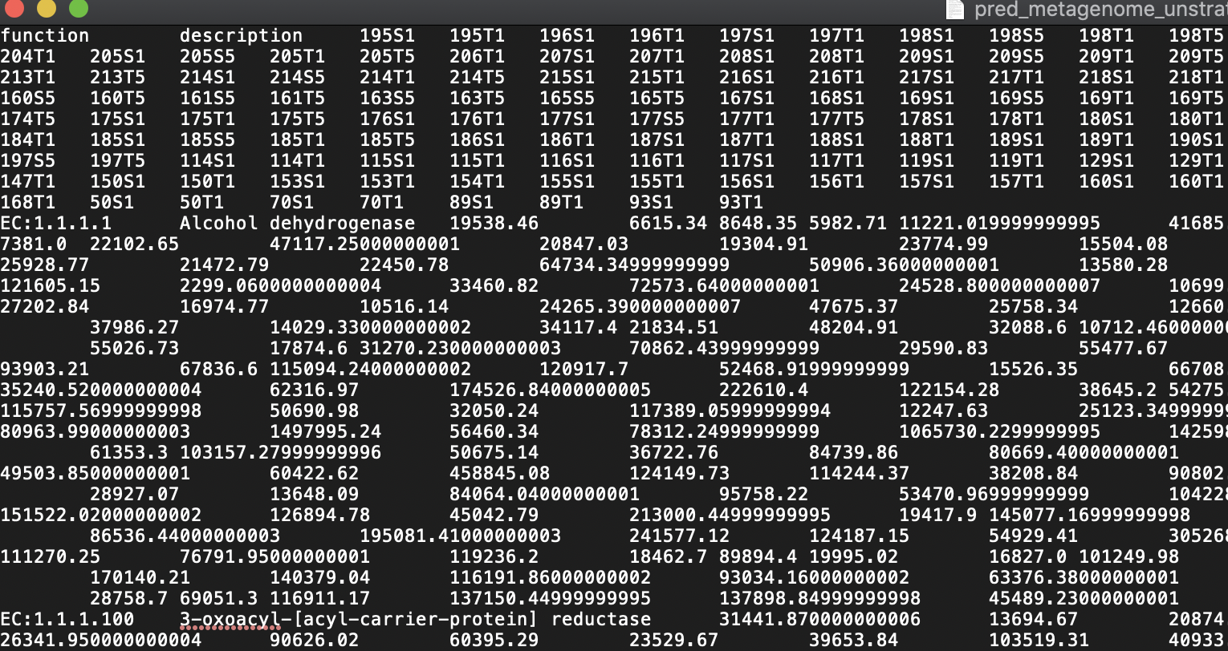
Final output files
MetaCyc pathway abundances per sample
EC abundances per sample

Slide 22
Analyzing EC/Metacyc pathway abundances
Bring files into R, using script provided on github
Make phyloseq object, because, well, it is just easier to work with a phyloseq object

Slide 23
KEGG pathway
pathway_pipeline.py -i KO_metagenome/pred_metagenome_unstrat.tsv -o Kegg_pathways --no_regroup --map Kegg-pathways.txt
Keg—pathways.txt is a file that I had to get from the github website at picrust2/picrust2/default_files/pathways_mapfiles/KEGG_pathways_to_KO.tsv – copy/paste into excel and save as tab-delimited

